Slide 1
Voice Controlled Vehicular
Robot
B161087-M.VENU
B161752-T.SALMAN
B161111-MD.FAROOQ

Slide 2
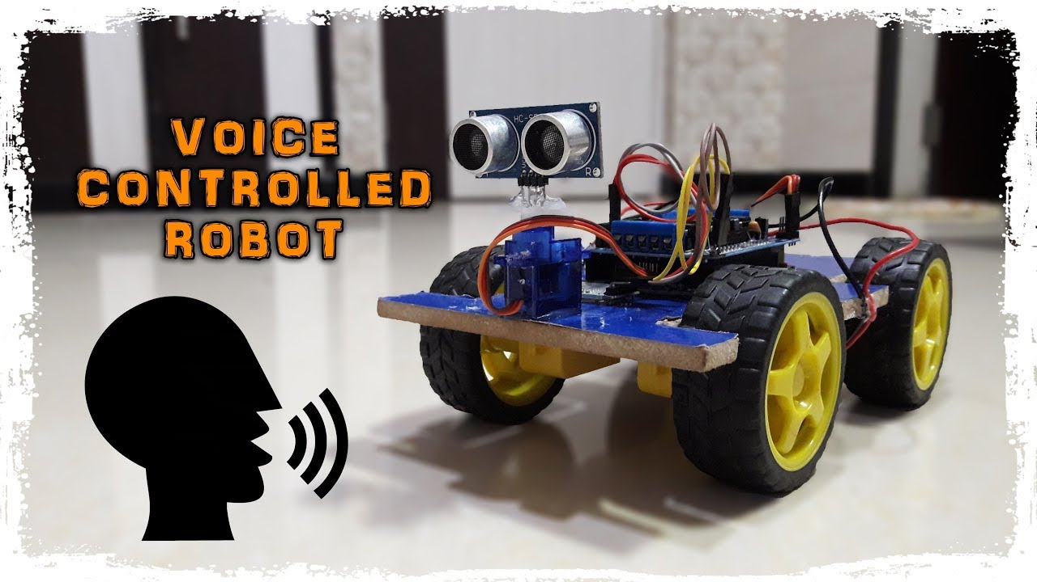

Slide 3
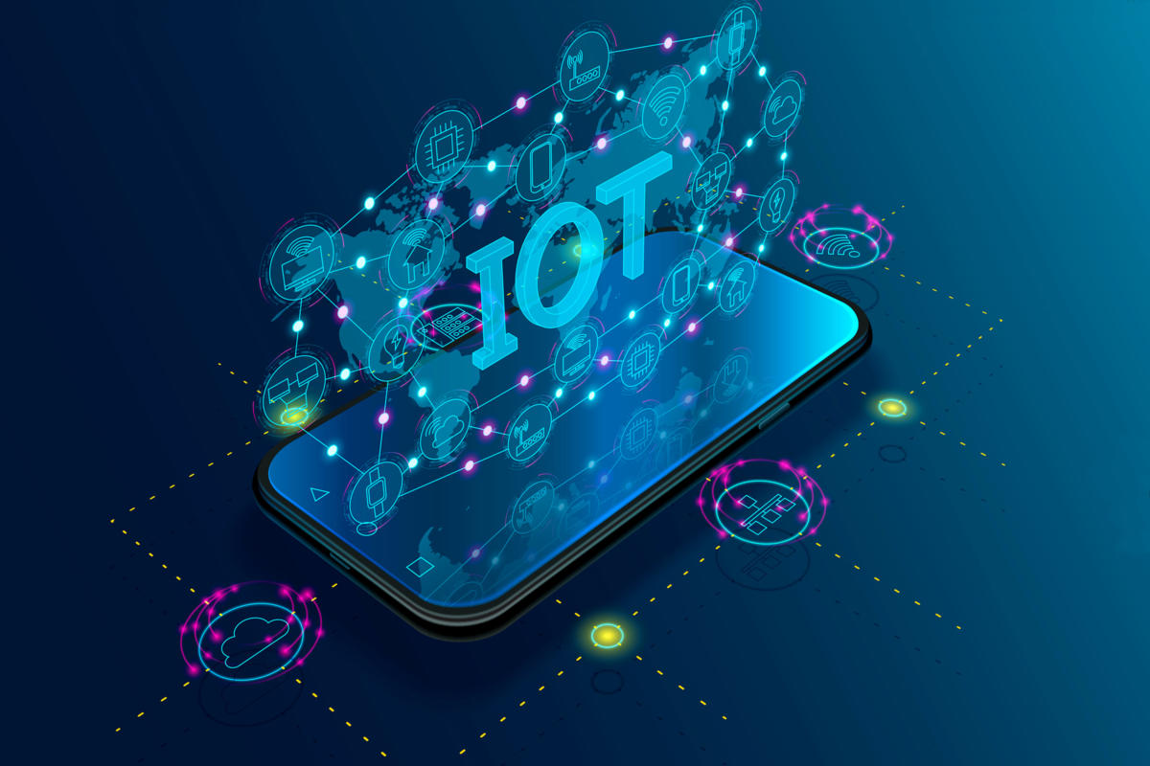

Slide 4
What is IoT ?
IoT means taking all the things in the world and connecting them to internet.

Slide 5
Building blocks of an IOT Device
Sensors + Actuators
Power
Processing(MCU)
Communication
Firmware

Slide 6
PROJECT DESCRIPTION:
We have built a vehicular robot which takes commands from the instructor through Google Assistant, works accordingly. It performs all the functions that a basic automobile does.
This Robot additionally has a cleaner which cleans any specified area on its own.

Slide 7
BLOCK DIAGRAM
(BRAN)
ARDUINO
SENSORS
MOTOR
DRIVER
DC MOTORS

Slide 8
COMPONENTS USED :
1 Arduino UNO
2 Ultrasonic sensors - 1
3 Motor driver(L293D)
4 DC motors – 200rpm
5 Robot chasis
6 Wheels - 4
7 Jumper wires
8 Batteries (5V 2A)
9 Breadboard
10 Bluetooth module
11 Dumping cable

Slide 9
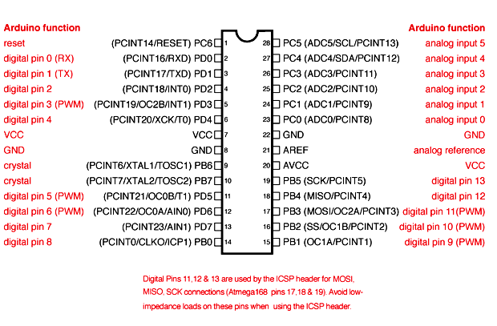
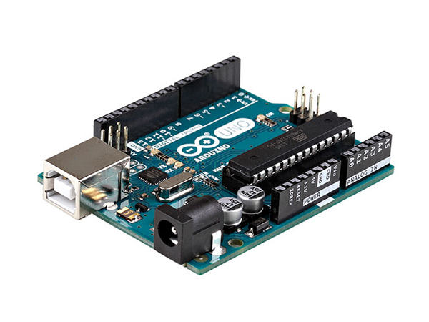
Arduino Uno
Arduino Uno Pin Configuration

Slide 10
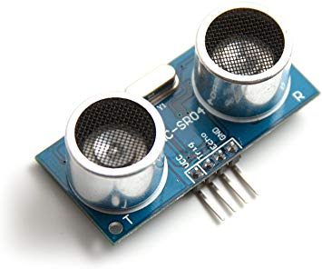
Ultrasonic Sensor

Slide 11
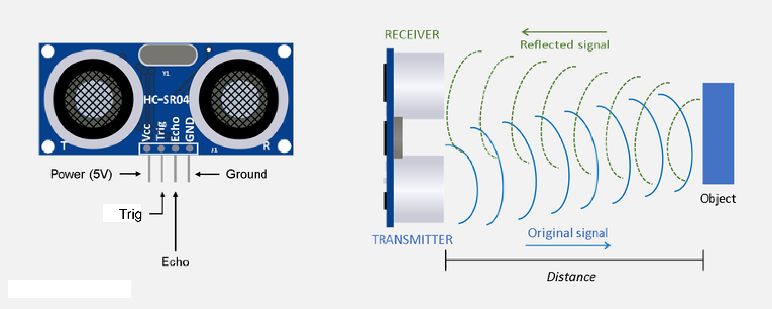
Ultrasonic Sensor working

Slide 12
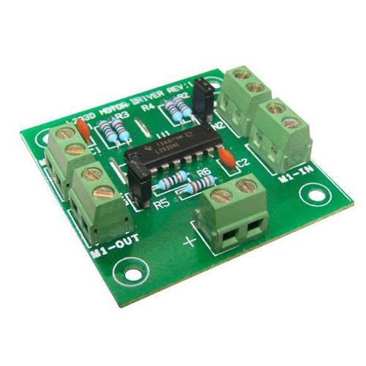
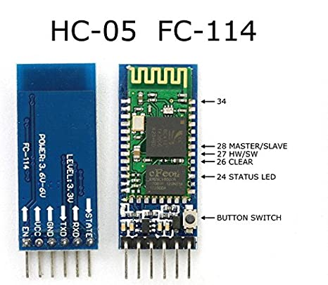
Bluetooth module
Motor Driver

Slide 13
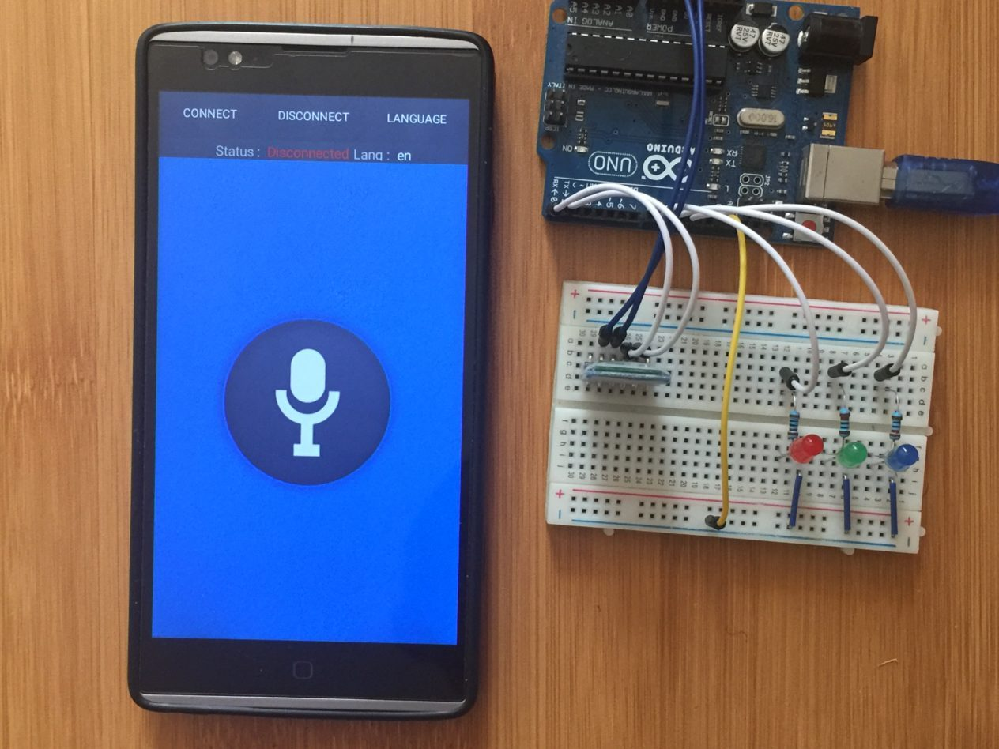
Software
Used
We have used an app called “Arduino Voice Control”. It is available in play store.

Slide 14
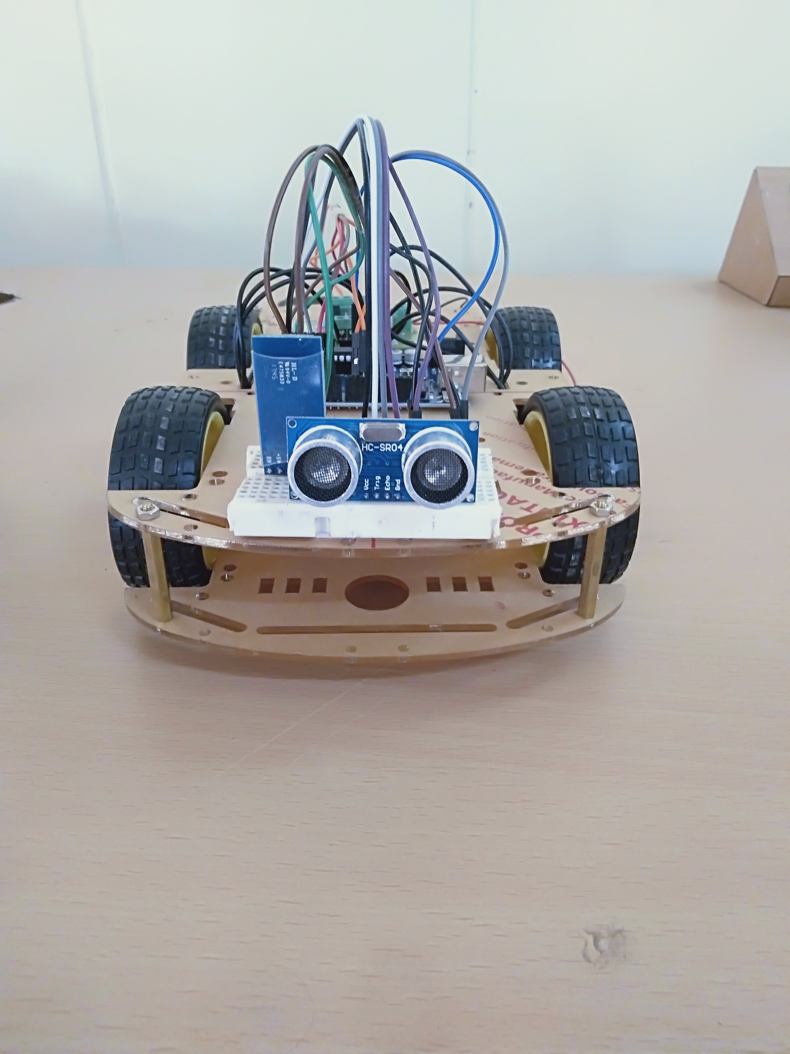
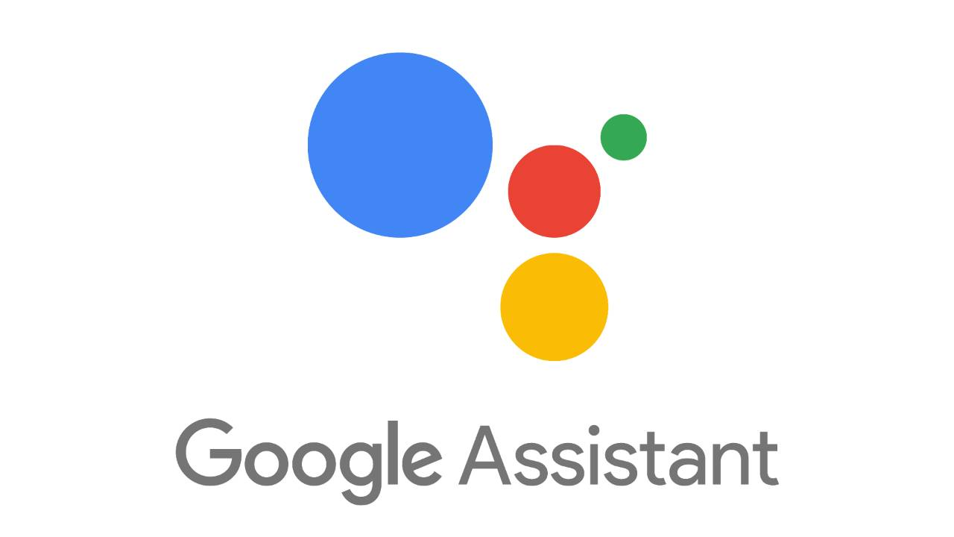

Slide 15
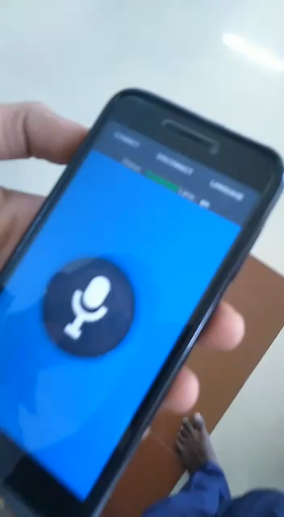

Slide 16
REAL TIME APPLICATION
=> Automatic voice controlled car
=> Self robotic cleaner.

Slide 17
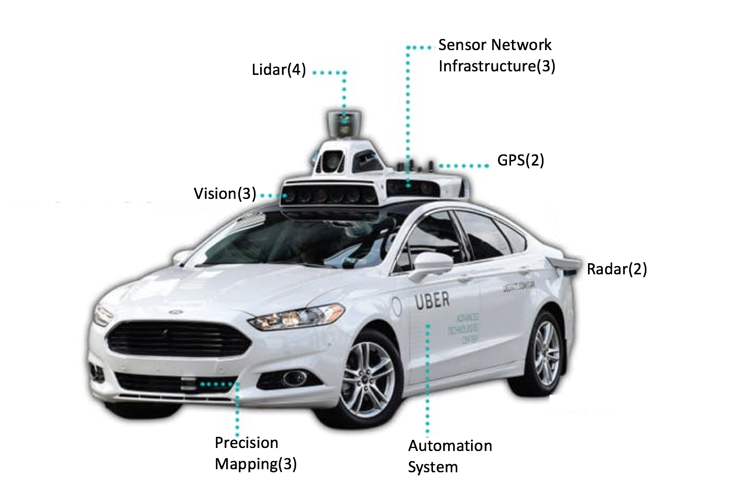

Slide 18
THANK YOU

